Slide 1

Workshop on Report Writing
By Sara Suleyman

Slide 2
Report Writing
Reports are written documents that give a reader information and ask the reader to do something.
To suggest new ideas and options
To ask people to accept a point of view
To influence a decision
To ask people make choices among alternative options

Slide 3
Report format
Title of the page
Contents list
Abstract
Introduction
Discussion
Conclusion
Summary
Recommendations
Appendices (and don’t forget to include reference page for academic reports)

Slide 4
Title
It is important to have a title or a title’s page in a longer report.
Title should be very focused and include the main topic covered.
Title’s page should include the title, name of the author, the date and who the report is for.

Slide 5
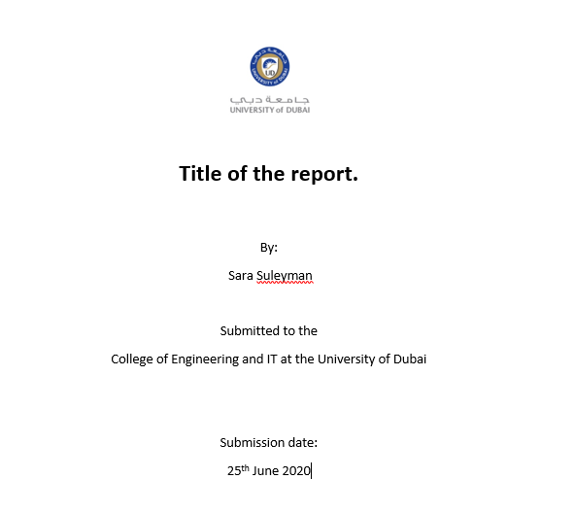

Slide 6
Contents list
Used in long reports rather than short ones.
A contents list helps the reader find their way around the report.
Keep the chapter titles simple and clearly worded so you don’t confuse the reader.
Ensure the pages are numbered so it is easy to move straight to the relevant section.
Be consistent if numbering chapters – don’t start with Chapter 1 and next have Chapter B and next have Chapter iii!
Don’t get too complex with a numbering scheme.
If your reader has to find Chapter 1.1.11.111.iii they might give up
– not to mention you losing your way.

Slide 7
Abstract
Normally only used in long and formal reports or if your work is being published.
It is the whole report, summarised in 80-200 words.
It tells the reader what you examined and why; what you discovered; how you did it and what conclusions you were led to.
It is really a file note for a reader to see if the whole document is worth reading.
Sometimes you will be asked to provide an abstract and the key words which give the reader an idea of what is covered/relevant.
For example, the key words in a handout on report writing could be: reports; purpose; content; structuring; styles; learning; building an argument…………………..

Slide 8
Abstract purpose
informative
Overview of the report
descriptive
Explain purpose, goal and methods
conclusive
What conclusions were drawn

Slide 9
Introduction
Should be quite brief. It can be a paragraph or a whole chapter but it should tell the reader:
The topic;
Who commissioned (asked for) it and when;
The reason for the report;
The terms of reference and limitations;
A brief outline of the background to the report;
The method of working (if this is very detailed it might form one of the appendices);
What sources have been used in researching the report (and again, if these are numerous the detail should be in the appendices and referenced);
The key issues which will be addressed (another way of ‘signposting’).

Slide 10
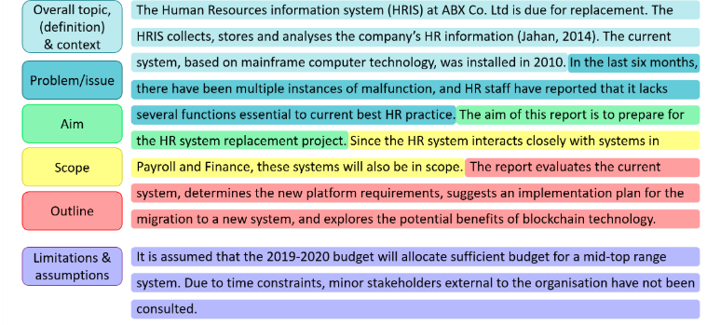
Example Report Introduction

Slide 11
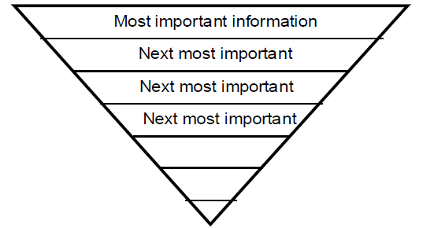
Discussion
The main body of the report and the longest part.
It goes into more detail about the subject.
It should be arranged logically in one or a series of chapters.
You should use headings and sub-headings to help the reader find their way around it.
Start with the most important information.

Slide 12
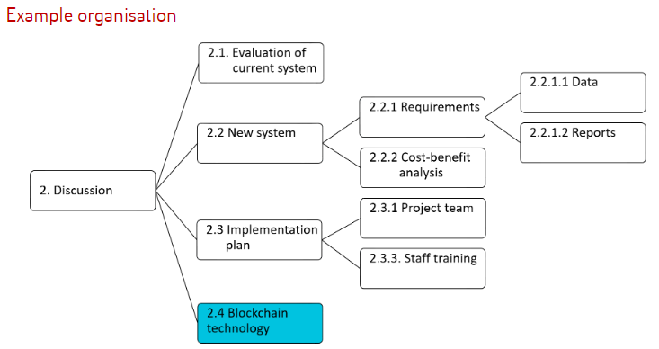
Organisation of a Discussion

Slide 13
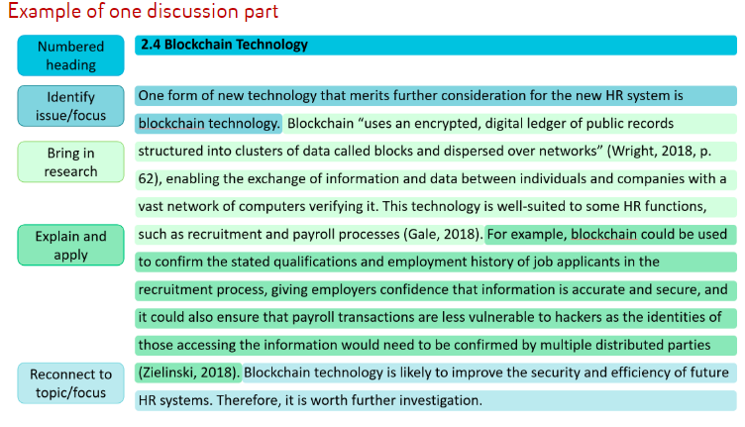

Slide 14
Conclusions
These are the main findings from the research that went into the report:
What you set out to find out – the purpose of the report
What you found out;
What was significant about what you discovered;
How it answers the question set by the person who commissioned the report.
Conclusions arise logically from the work you have already done. You shouldn’t present any new information here. Just use the information you have collected to inform the options, indicators, lessons or advice you wish to give the readers.

Slide 15
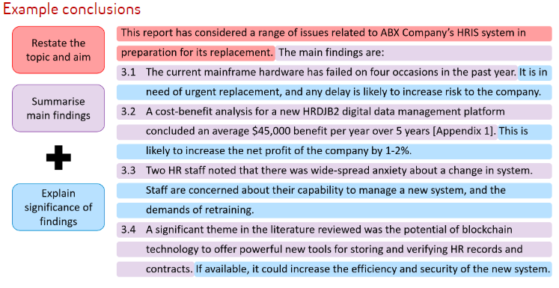
Example Conclusion

Slide 16
Summary
The key information from the report, often presented in bullet points or short paragraphs.
It mainly summarises the high points – the findings and conclusions, rather than discussing what, when and how again.
A summary can often be separated from and read instead of the whole report, so a brief introduction to the summary could be used.
Summaries are often placed at the front of long reports in recognition that the long report will be too much for many busy readers to take in.

Slide 17
Recommendations
When a report is being used to present options or make some recommendations for action you have to give the reader some clues about what these might be.
Again, don’t leave the preferred option or course of action until last. Use that ‘inverted triangle’ approach here too.
So you should present your most favoured ideas, options or recommendations first.
These are likely to be debated more thoroughly by the readers and they will ideally come to a more informed decision (the one you prefer!).

Slide 18
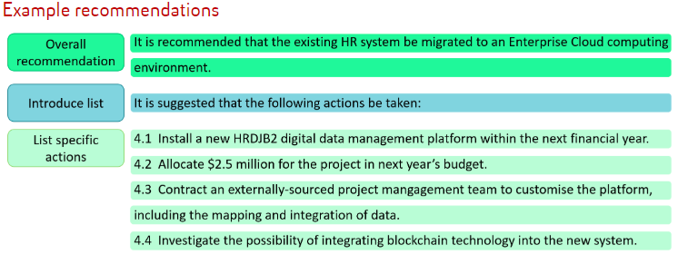
Example Recommendation

Slide 19
Appendices
NOTE: You refer to one appendix or several appendices. However you can refer to the whole collection of appendices as ‘the Appendix’.
You use the Appendix to ‘dock’ informative and helpful information here.
You shouldn’t use too many appendices – they should never overwhelm the report itself.
If you have done some research, put the (blank) questionnaire or interview questions here.
You can insert (short) documents from other sources (for example, a brief summary of another report which would be helpful to the reader).
Tables, photographs, drawings or maps which will help the reader make sense of the report can be inserted into the appendices.
Be selective and don’t forget to provide the ‘signpost’ to the relevant appendix in the body of your report - put the relevant appendix you want the reader to look at in brackets, for example, (Appendix 1) or (see Appendix 1).

Slide 20
References
As you may well be writing your report as an assignment, you must reference all the sources you use in the body of the report and always have a reference list whenever you are asked to write a report at university.
This is not always required in a report in the workplace, although crediting the sources you have used is a courtesy.

Slide 21
Report Style
Knowing about the function and structure of reports is important;
however, knowing about the appropriate style and conventions to use when writing your report is equally important.
Reports written in a university context tend to be structured, formal, objective, impersonal, complex and contain technical language.

Slide 22
Reporting language
According to X...
It is the view of X that ...
The opinion of X is that ...
In an article by X, ...
Research by X suggests that ...
X has expressed a similar view.
X reports that ...
X notes that ...
X states that ...
X observes that ...
X concludes that ...
X argues that ...
X found that ...
X discovered that ...

Slide 23
Reporting Language cont…..
This report aims to investigate...
This report was commissioned to review...
This research indicates...
The results suggest...
It can be concluded that...
Conclusions that can be drawn are...
It recommends that...
The following recommendations are made...

